Slide 1
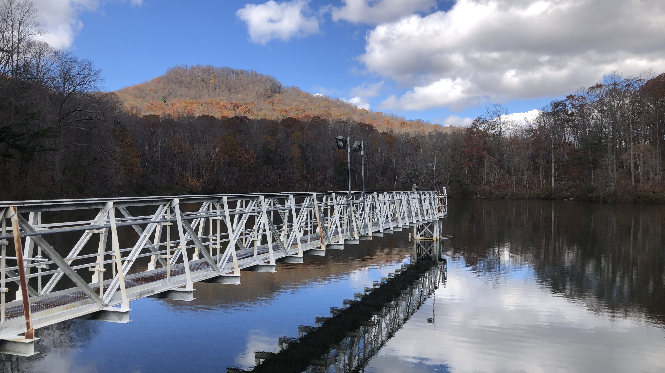
NEAR-TERM, ITERATIVE FORECASTS HIGHLIGHT THE RELATIVE IMPORTANCE OF TWO DRIVERS FOR DYNAMIC OXYGEN CONCENTRATIONS IN A DRINKING WATER RESERVOIR Abigail Lewis, Ryan McClure, Paul Hanson, and Cayelan Carey
@lewis_lakes
Notes:
Hi, my name is Abby Lewis and today I am going to be talking about a project I led that used NEAR-TERM, ITERATIVE FORECASTS to understand OXYGEN dynamics IN A DRINKING WATER RESERVOIR

Slide 2
75% of human water use comes from rivers, lakes, and reservoirs
Reservoirs alone bury more carbon than ocean sediments each year
Notes:
My work is based in reservoirs are critical to understand for several reasons. First, reservoirs are important as a source of freshwater for people around the world. 75% of human water use comes from a combination of rivers, lakes, and reservoirs. Second, reservoirs play a critical role in the global carbon cycle. Each year, reservoirs around the world bury more organic carbon than all ocean sediments. This serves as an important and understudied ecological carbon sink.

Slide 3
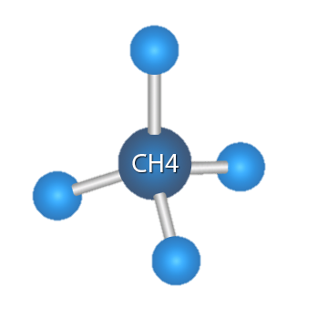
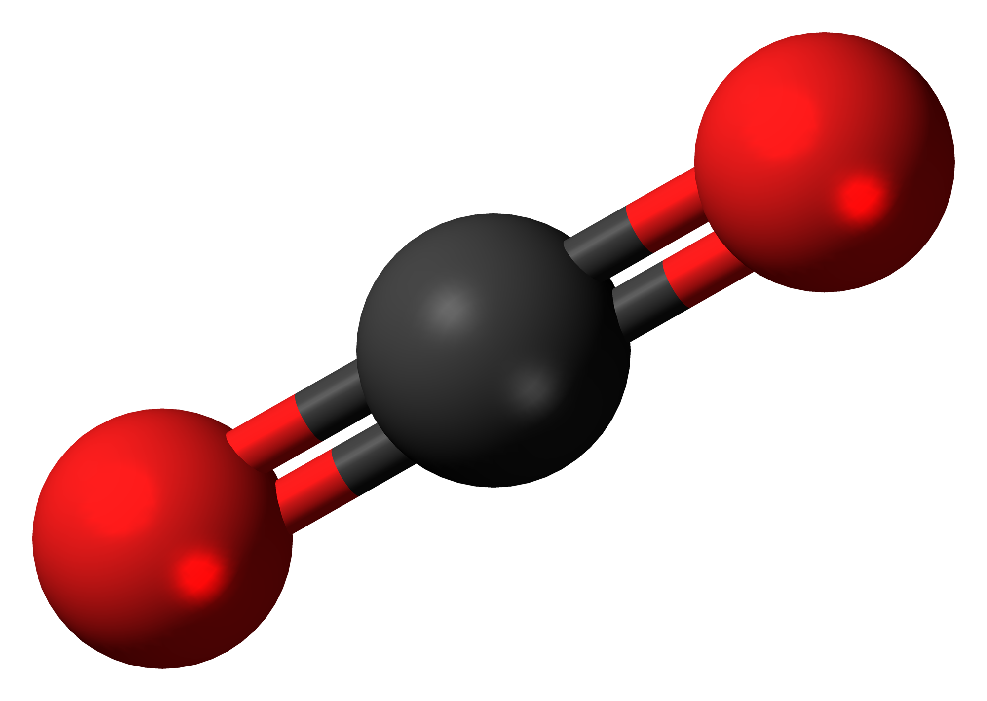
The extent to which reservoirs perform either of these functions depends on oxygen demand
CO₂
Notes:
The extent to which reservoirs are able to perform either of these important functions relates to the rate of oxygen consumption in the reservoir, which we call oxygen demand.
High rates of biological oxygen demand mean that more carbon is being mineralized, increasing GHG production and potentially increasing carbon emissions from reservoirs. High rates of oxygen demand can also cause oxygen concentrations to decrease to the point where you see deteriorating water quality or release of nutrients such as nitrogen and phosphorus which cause harmful algal blooms.

Slide 4


Previous research indicates oxygen demand is dependent on temperature and ambient oxygen concentrations, among other factors
O₂
Notes:
We know that a variety of factors can influence the rate of oxygen demand, including temperature and oxygen concentrations.
Temperature increases oxygen demand by accelerating biological and chemical processes that consume oxygen,
likewise increased oxygen availability can accelerate diffusion of oxygen into anoxic sediment and release oxygen limitation of bacterial respiration, all increasing the rate of oxygen demand

Slide 5





Changes in climate and land use are driving divergent trends in oxygen demand
[O₂]
O₂
[O₂]
Notes:
It is difficult to predict how the rate of oxygen demand will change over time in a given body of water, in part because changes in climate and land use are having divergent effects on oxygen demand.
Water temperatures in the upper layer of a lake or reservoir are generally increasing around the world, potentially increasing the rate of oxygen demand and decreasing oxygen concentrations.
At the same time, bottom-water temperatures are generally decreasing as a result of increased shading from dissolved organic carbon, which would decrease the rate of oxygen demand and lead to higher oxygen concentrations.
Finally, increased storm frequency and intensity can directly increase oxygen concentrations in lakes and reservoirs
In light of these heterogeneous changes, it is important that we understand the relative importance of temperature and oxygen concentrations as drivers as oxygen demand, so that we can predict how water quality and carbon cycling in reservoirs, will change over time.

Slide 6

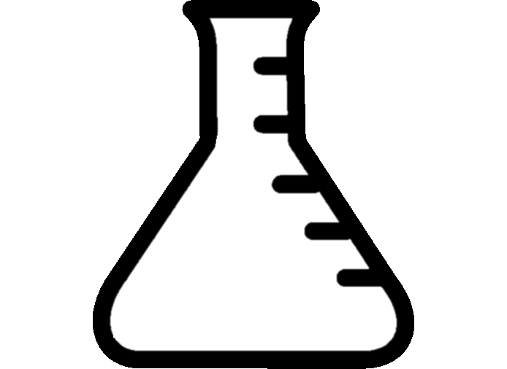
More information is needed to determine how these factors interact in lakes and reservoirs
≠
Notes:
Finally, it is worth noting that most previous research that has been done on oxygen demand has been done in small-scale incubations, making it difficult to assess how these factors will interact on the scale of a whole reservoir.

Slide 7
How does the relative importance of temperature and oxygen as drivers of bottom-water oxygen demand change over time?

Slide 8
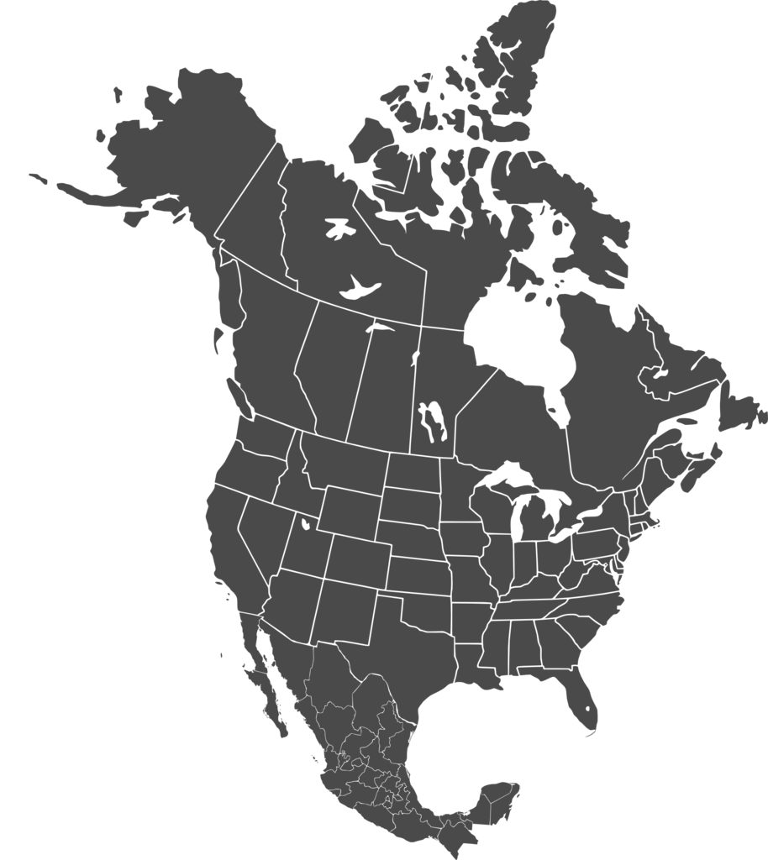

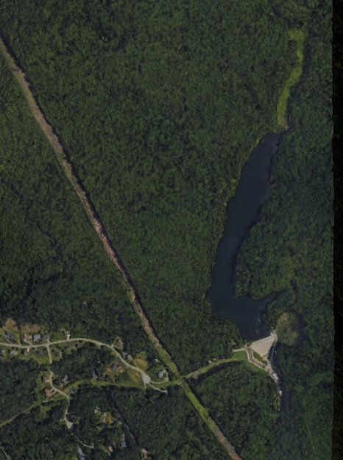
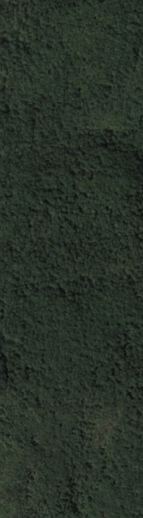
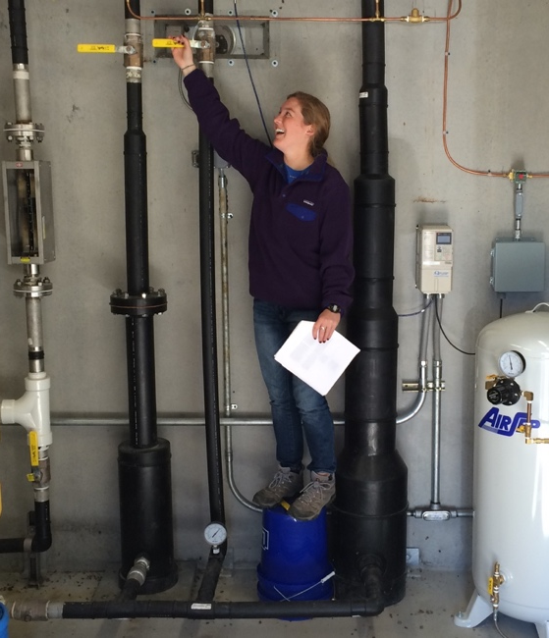

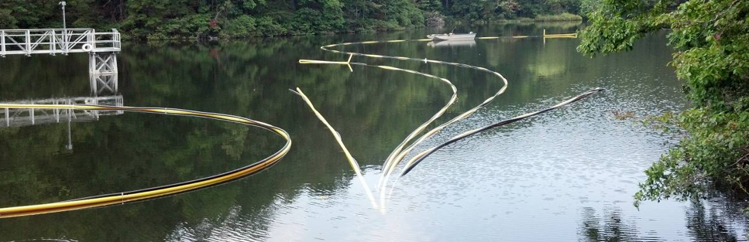
Six years of oxygenation have provided a unique opportunity to analyze these factors on a whole-ecosystem scale
Falling Creek Reservoir
1 km
Notes:
To develop my forecasting framework, I used historical time series data from Falling Creek Reservoir, located in southwest Virginia.
Falling Creek is equipped with an oxygenation system that can add oxygen to bottom waters of the reservoir without decreasing thermal stability. The oxygenation system operates at the bottom of the reservoir, but in this photo on the bottom here we had a perfect photo opportunity when we brought the system up to the surface for maintenance. Oxygenation can be turned on an off on demand by scientists and managers, as shown in the picture above.
Starting in 2013, this oxygenation system has been operated on a variable schedule, providing a perfect dataset that disentangles seasonal correlations between oxygen concentrations and temperatures, helping us isolate the separate impacts of oxygen and temperature on oxygen demand.

Slide 9



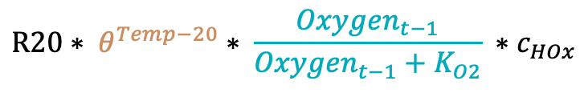
Alternative model structures test the importance of two drivers of oxygen demand
Full model
Oxygenation System
Oxygen Demand
$${DO}_{t}={DO}_{t−1}+HOx −oxygen demand$$
O₂
O₂
O₂
$$R20∗ θ^{Temp−20}∗ \frac{{Oxygen}_{t−1}}{{Oxygen}_{t−1}+K_{O2}} ∗c_{HOx}$$
Temperature-only model
Oxygen-only model
$$oxygen demand= R20∗ \frac{{Oxygen}_{t−1}}{{Oxygen}_{t−1}+K_{O2}} ∗c_{HOx}$$
$$oxygen demand= R20∗ θ^{Temp−20} ∗c_{HOx}$$
Notes:
To understand the dominant drivers of oxygen demand, I took the original model that contained sensitivity to both temperature and oxygen, and I divided it into two separate models. The temperature-only model included temperature as a driver, but not oxygen concentrations, and the oxygen-only model included oxygen as a driver, but not temperature. I then compared the relative performance of forecasts based on each of these models across the six-year time series to assess when each driver is most important

Slide 10
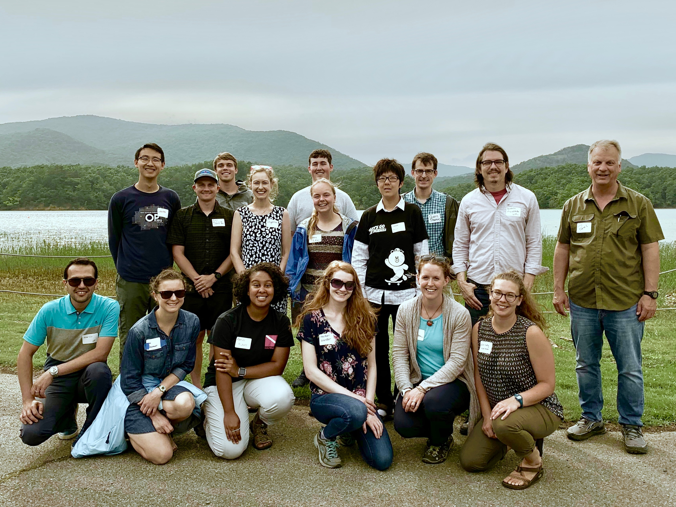


aslewis@vt.edu
@lewis_lakes
Notes:
I want to thank the Carey lab for collecting all of these data over the past six years, and the western Virginia water authority for allowing us to do work in their beautiful reservoirs. Thanks everyone for listening, and I’m happy to take any questions!

Slide 12
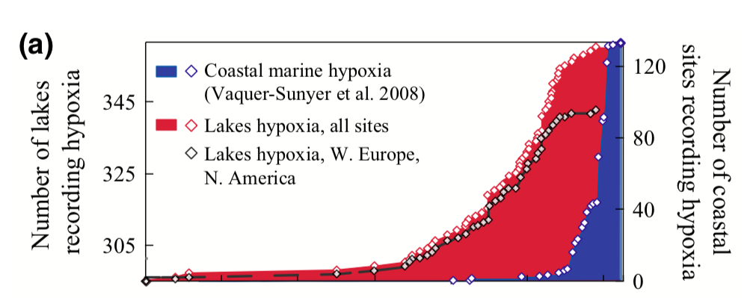
Jenny et al. (2016)

Slide 13
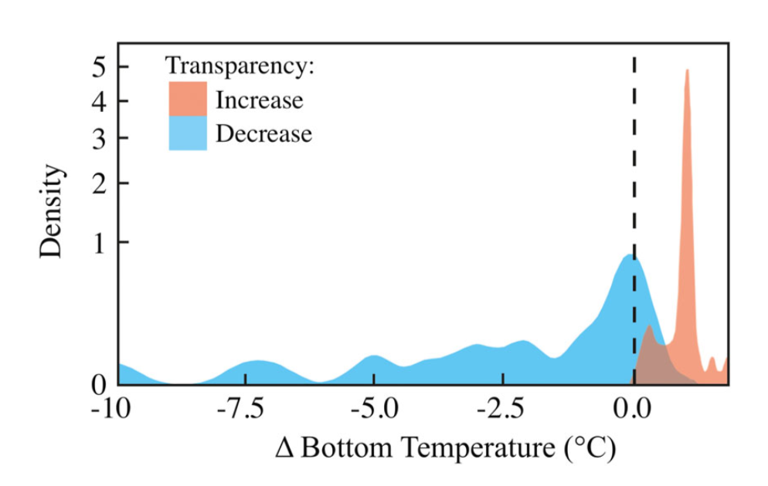
Heterogeneous global changes have led to uncertainty about future oxygen dynamics

Slide 14

Changes in climate and land use are driving heterogeneous trends in oxygen demand
O₂
O₂
O₂

